Slide 1
Signalling
Systems Software and Networks
Software Development
Patrick Donohue

Slide 2
Topics
Waves
Exponents and Logarithms
Decibels
Time and Frequency
Noise
Signals
Attenuation
Crosstalk
Cable Testing

Slide 3
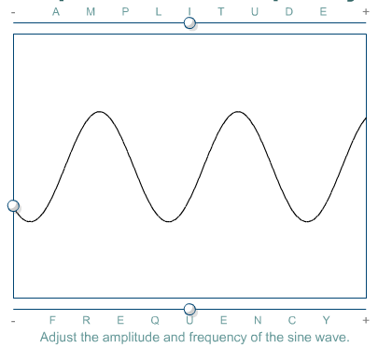
Waves
A wave is energy traveling from one place to another.
Networking professionals are specifically interested in voltage waves on copper media, light waves in optical fiber, and alternating electric and magnetic fields called electromagnetic waves.

Slide 4
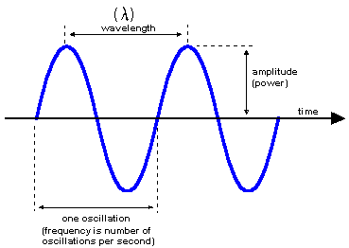
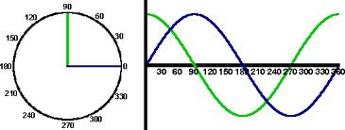
Sine Waves
Why is a Sine Wave called a Sine Wave?
Check out the following animation.
http://www.rkm.com.au/ANIMATIONS/animation-sine-wave.html
So if we plot every angle between 0 and 359 degrees using x,y co-ordinates we get a sine wave.

Slide 5
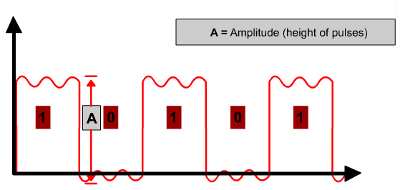
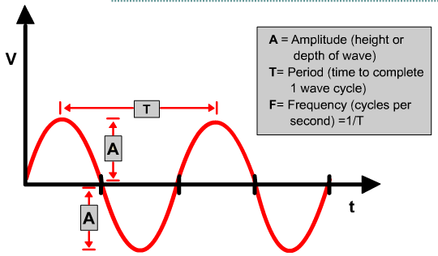
Sine Waves and Square Waves
Sine waves, or sinusoids, are graphs of mathematical functions that repeat the same pattern at regular intervals.
Square wave graphs do not continuously vary with time. The values remain the same for some time, and then suddenly change.

Slide 6
Exponents and Logarithms
In networking, there are three important number systems:
Base 2 – Binary
Base 10 – Decimal
Base 16 – Hexadecimal
Decimal numbers have 10 different placeholders, the numbers 0 through 9.
Hexadecimal numbers have 16 different placeholders, the numbers 0 through 9 and the letters A through F.
A logarithm is essentially the opposite of an exponent. A logarithm equals the exponent that a given base would have to be raised to in order to generate a certain value.

Slide 7
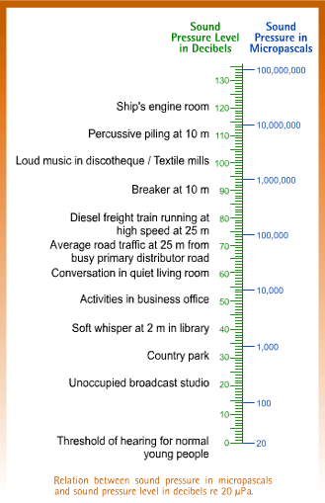
Decibels (Sound)
Sound is produced by changes in air pressure
Air pressure is measured in Pascals
The units used can get quite large so a logarithmic value is used instead
This value is measured in Decibels (dB).
Decibels can also be used to measure the level of signal or electronic noise

Slide 8
Decibels (Electronics)
There are two formulas for calculating decibels:
dB = 10 log₁₀ (P_{final} / P_{ref})
dB = 20 log₁₀ (V_{final} / V_{ref})
The first formula describes decibels in terms of power (P), and the second in terms of voltage (V).
Typically, light waves on optical fiber and radio waves in the air are measured using the power formula.
Electromagnetic waves on copper cables are measured using the voltage formula.

Slide 9
Viewing Signals in Time and Frequency
Data symbolizing characters, words, pictures, video, or music can be represented electrically by voltage patterns on wires and in electronic devices.
The data represented by these voltage patterns can be converted to light waves or radio waves, and then back to voltage waves.

Slide 10
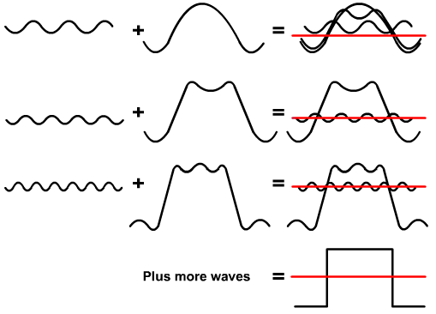
Analog and Digital Signals in Time and Frequency

Slide 11
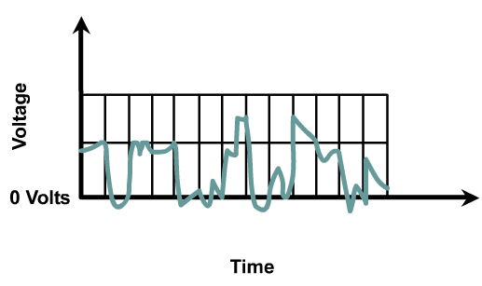
Noise in Time and Frequency
There are many possible sources of noise:
Nearby cables that carry data signals
Radio frequency interference (RFI), which is noise from other signals being transmitted nearby
Electromagnetic interference (EMI), which is noise from nearby sources such as motors and lights
Laser noise at the transmitter or receiver of an optical signal

Slide 12
Bandwidth
Analog bandwidth typically refers to the frequency range of an analog electronic system.
Digital bandwidth measures how much information can flow from one place to another in a given amount of time.
1 kbps = 1000 bps
1 Mbps = 1,000,000 bps = 1000 kbps
1 Gbps = 1,000,000,000 bps = 1,000 Mbps

Slide 13
Signals and Noise

Slide 14
Signaling over Copper and Fiber
On copper cable, data signals are represented by voltage levels that represent binary 1s and 0s
Shielded (coaxial cable) and unshielded
There are two types of twisted-pair cable: shielded twisted pair (STP) and unshielded twisted pair (UTP).
Fiber-optic cable is used to transmit data signals by increasing and decreasing the intensity of light to represent binary 1s and 0s.

Slide 15
Attenuation and Insertion Loss on Copper Media
Attenuation is the decrease in signal amplitude over the length of a link.
Impedance discontinuities caused by defective or improperly installed connectors also contributes to attenuation.
Impedance is a measurement of the resistance of the cable to alternating current (AC), and is measured in ohms.

Slide 16
Noise on Copper Media
Crosstalk involves the transmission of signals from one wire to a nearby wire.
It can also be caused by signals on separate, nearby cables.
When crosstalk is caused by a signal on another cable, it is called alien crosstalk. Crosstalk is more destructive at higher transmission frequencies.
Cable testing instruments measure crosstalk by applying a test signal to one wire pair. The cable tester then measures the amplitude of the unwanted crosstalk signals induced on the other wire pairs in the cable.

Slide 17
Types of Crosstalk
There are three distinct types of crosstalk:
Near-end crosstalk (NEXT)
Far-end crosstalk (FEXT)
Power sum near-end crosstalk (PSNEXT)

Slide 18
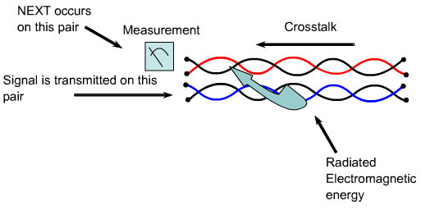
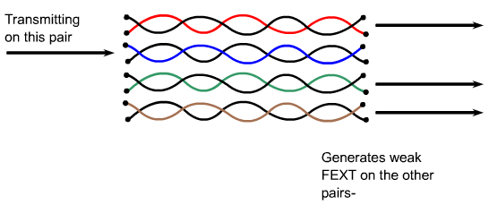
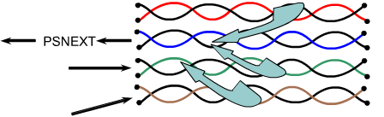
Types of Crosstalk
Near-end crosstalk (NEXT) is computed as the ratio of voltage amplitude between the test signal and the crosstalk signal when measured from the same end of the link.
FEXT crosstalk occurs further away from the transmitter and creates less noise on a cable than NEXT.
PSNEXT is computed for each wire pair based on the NEXT effects of the other three pairs.

Slide 19
Cable Testing Standards
TIA/EIA standards
Greatest impact on networking media standards
TIA/EIA-568-A
Most widely used standards for technical performance of networking media
Differentiating between connections
RJ-11, RJ-45, DB 15
UTP implementation
RF-45

Slide 20
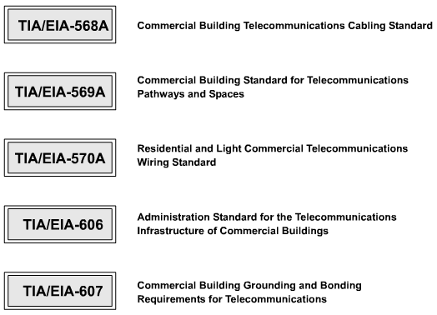
TIA/EIA Standards

Slide 21
Details of TIA/EIA-568-A
TIA/EIA standards address the following six elements of the LAN cabling process:
Horizontal cabling
Telecommunications closets
Backbone cabling
Equipment rooms
Work areas
Entrance facilities

Slide 22
Time Base Parameters
Propagation delay is a simple measurement of how long it takes for a signal to travel along the cable being tested.
The delay in a wire pair depends on its length, twist rate, and electrical properties.
Delays are measured in the hundredths of nanoseconds.
Testers measure the length of the wire based on the electrical delay as measured by a Time Domain Reflectometry (TDR) test, not by the physical length of the cable jacket.

Slide 23
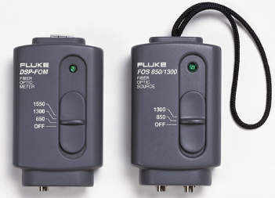
Testing Optical Fiber
On a fiber-optic link, the acceptable amount of signal power loss that can occur without dropping below the requirements of the receiver must be calculated.
A fiber test instrument checks whether the optical link loss budget has been exceeded.

Slide 24
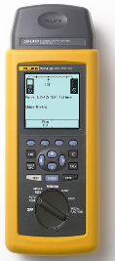
New Standard
On June 20, 2002, the Category 6 (or Cat 6) addition to the TIA-568 standard was published.
This new standard specifies the original set of performance parameters that need to be tested for Ethernet cabling as well as the passing scores for each of these tests.
A quality cable tester is the Fluke DSP-LIA013 Channel/Traffic Adapter for Cat5e.

